Slide 1
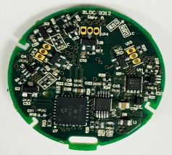
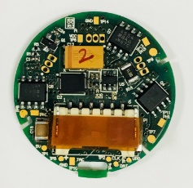
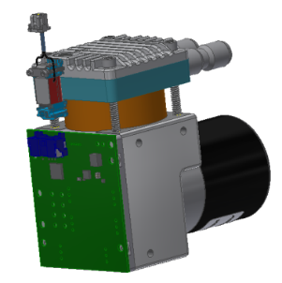
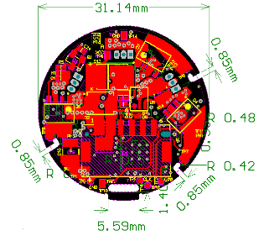
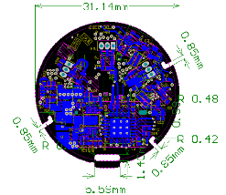
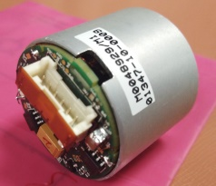
BLDC Motor Controller Board - Development
Division: PFD
Scope
The scope of the project was to develop a common PCB to provide platform for the 6V, 12V and 24V BLDC Motors (Power of 24W).
The scope also includes development of firmware and functional testing of the controller boards.
Targeted for 33mm controller board size.
Challenges
Some of the functional testing at client location because of dependency on the end customer application setup
Altimum for schematics and PCB layout designing
MP LAB IDE
8-bit PIC Microcontroller
Pickit3 Debugger
SVN
UART for diagnostics
Benefits and Improvements
Solution
Hardware, firmware completely owned by POEC.
Cost target of $5 per board achieved.
Accommodated the board size within the targeted controller board size.
End to End development of controller board

